Slide 1
Introduction
This project “Bank Analytics” focuses on analysing customer banking activities using two primary datasets .
one containing customer debit and credit transaction details, and another containing bank loan records.
The main objective of the project is to gain insights into customer financial behaviour, loan distribution, and overall banking performance. To achieve this, multiple data analytics and visualization tools were used:
Excel Dashboard for the initial representation of actual data.
SQL combined with Power BI for structured query outputs and interactive dashboards.
Tableau Dashboard for advanced visualization and deeper insights.

Slide 2
Problem Statement
Banks generate huge volumes of transactional and loan data every day. However, this data often remains underutilized due to lack of proper analysis and visualization. The key challenges are:
Difficulty in tracking customer debit and credit patterns effectively.
Lack of a unified system to analyse loan data alongside transaction data.
Limited ability to derive real-time insights from raw SQL query outputs.
Absence of interactive dashboards for decision-making.
Challenge in identifying key performance indicators (KPIs) that drive banking growth and risk assessment.
This project addresses these challenges by integrating data analytics and visualization tools to transform raw banking data into actionable insights.

Slide 3
KPIs & Insights
Key Performance Indicators and insights
Total Loan Applications – Measures the number of loan requests received (65.5K)
Total Amount Collected – Amount repaid by customers ($814.9M)
Total Interest Collected – Interest earned from loans ($155M+)
Average Interest Rate – Average percentage of interest across loans (12%)
Active Loans – Number of currently running loans (28,654)
Disbursement Trend – Loan distribution trend across financial years
Total Credit Amount – $127.6 Million
Total Debit Amount – $127.3 Million
Credit to Debit Ratio – 1.0025
Net Transaction Amount – $318.1K

Slide 4
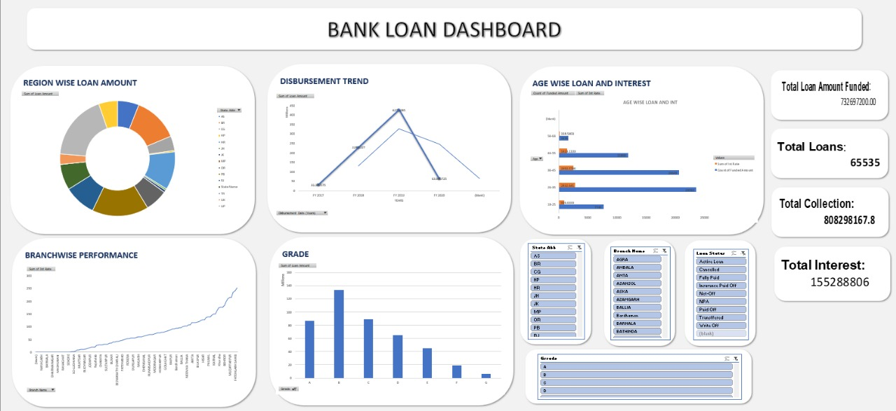
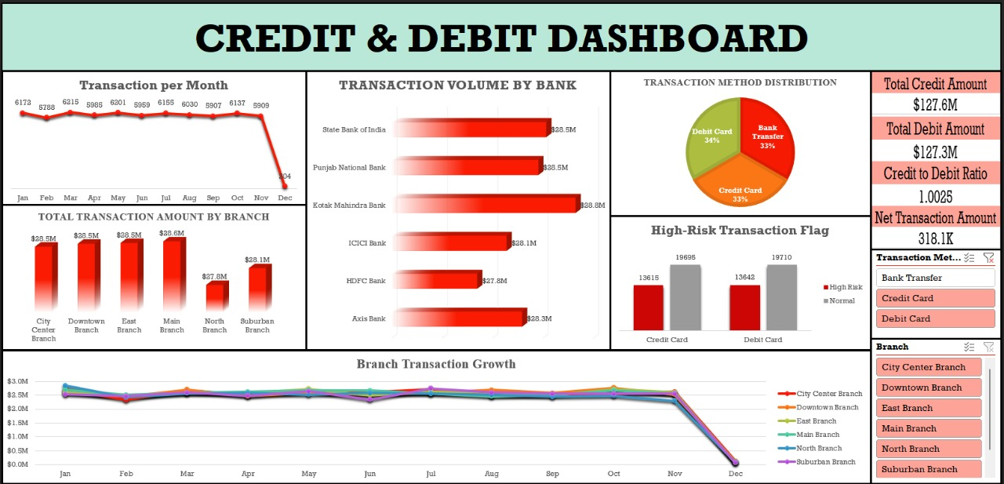
Excel Dashboard
Showcase of final dashboard developed in excel

Slide 5
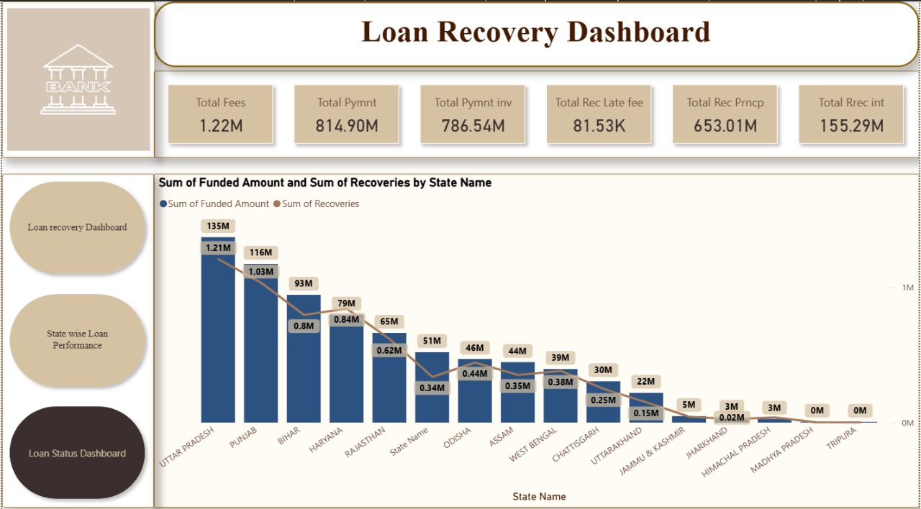
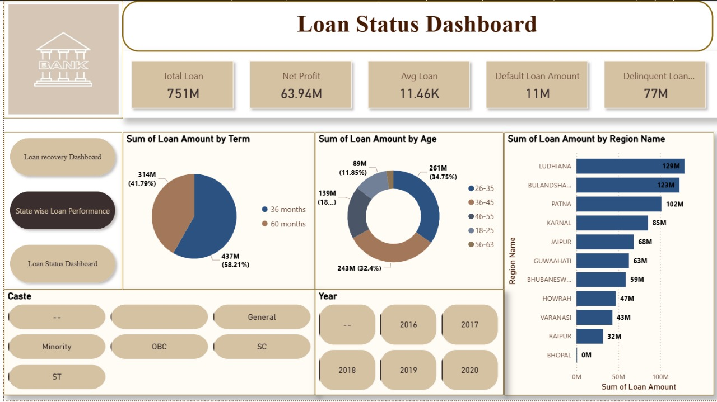
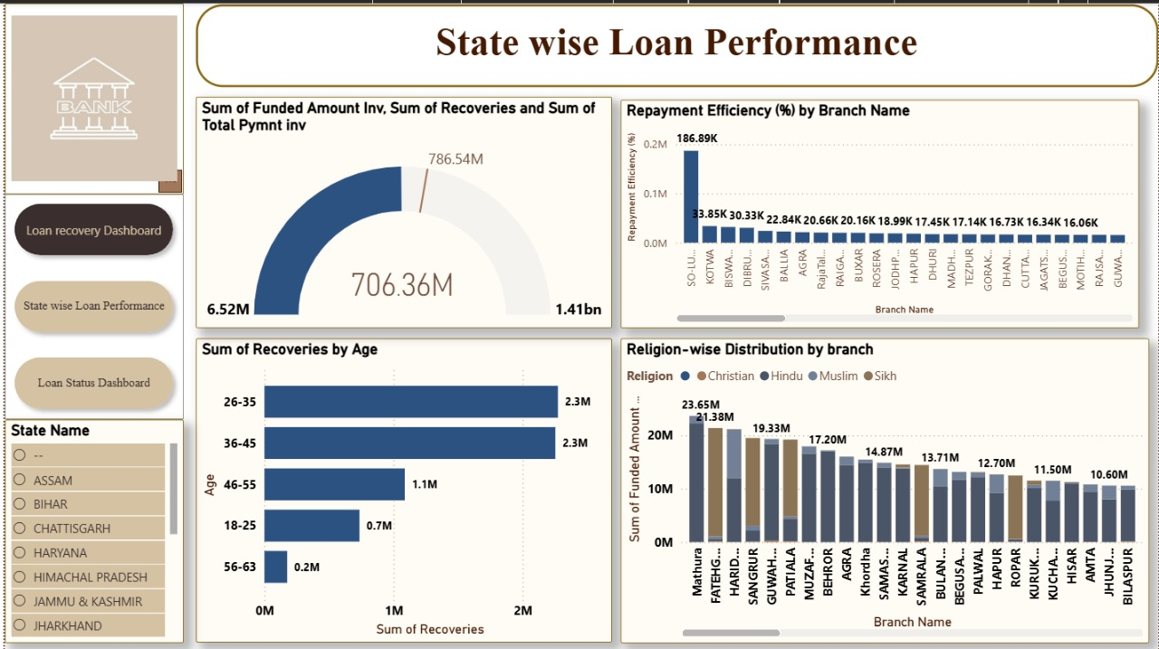
Power BI Dashboard
Screenshot of Power BI dashboard

Slide 6
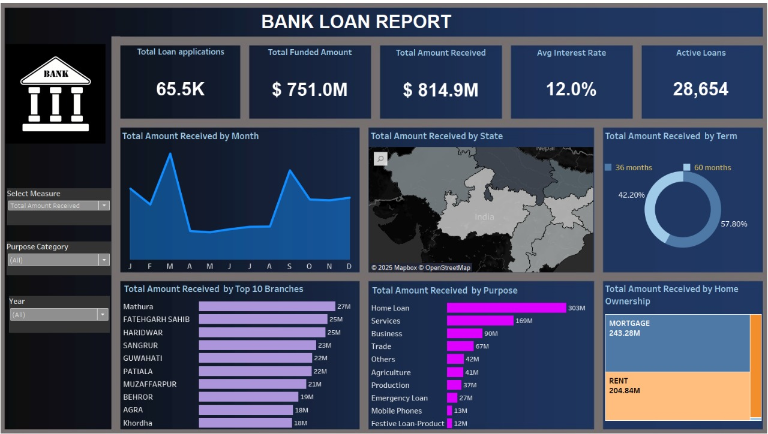
Tableau Dashboard
Screenshot of Tableau dashboard

Slide 7
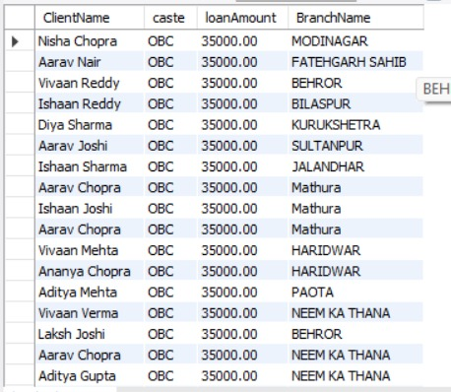
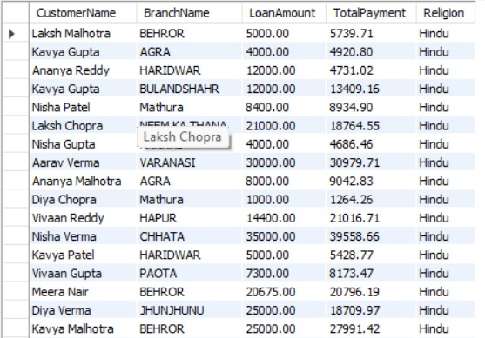
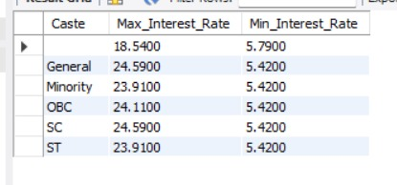
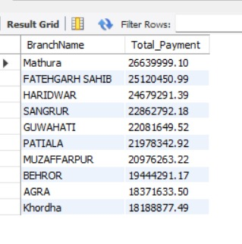
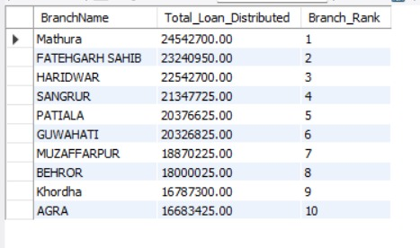
SQL Queries Output
Display output of SQL queries here

Slide 8
Project Summary
Summary of findings and key learnings
Key Findings:
Loan Data Analysis
Total loan applications stood at 65.5K, with a funded amount of $751M and collections of $814.9M.
The average interest rate (12%) and active loans (28,654) highlight the bank’s significant lending portfolio.
Disbursement trends show yearly variation in sanctioned loans.
Region-wise, branch-wise, and purpose-wise dashboards reveal performance differences across geographies and loan categories.
Credit & Debit Data Analysis
Total Credit ($127.6M) and Total Debit ($127.3M) values are almost balanced, giving a Credit to Debit Ratio of 1.0025.
Transaction methods were evenly distributed: Debit Card (34%), Bank Transfer (33%), Credit Card (33%).
High-Risk Transactions were flagged in both credit and debit cards (~13.6K each), requiring stronger fraud detection.
Among banks, Kotak Mahindra Bank ($28.5M) showed the highest transaction volume, followed by Punjab National Bank, SBI, ICICI, HDFC, and Axis with similar volumes.

Slide 9
Key Learnings
KPI Tracking Improves Decisions Monitoring metrics like active loans, interest collected, and disbursement trends helps banks align with business goals.
Visualization Enhances Understanding Dashboards (Power BI, Tableau, Axial) make complex data easier to interpret.
Branch & Bank-Level Insights Comparing performance across branches and banks supports strategic planning
SQL + BI Integration Structured queries combined with visualization tools increase accuracy and accessibility.
Customer Profiling Age, grade, and purpose-based loan segmentation helps in targeted product offerings.
Real-time Monitoring Dashboards provide timely alerts on risks and performance trends.
Scalable Analytics Framework The project shows how analytics can be scaled to larger banking datasets in the future
A nearly Balanced Credit-debit ratio indicates strong customer financial discipline.
High-risk transaction monitoring is crucial , especially for credit and debit card usage.
Loan disbursement and repayment trends reveal valuable insights for strategic decision-making.
Combining SQL queries with BI tools enhances both data accuracy and visualization power.
.

Slide 10
Solutions & Improvements
Customer Segmentation & Targeting Analyze age, income, and purpose-based loan data to offer personalized loan products.
Improve cross-selling opportunities (credit cards, insurance, savings plans).
Branch & Bank Performance Optimization Use KPIs to identify underperforming branches and improve training, resources, and policies. Reward high-performing branches to maintain competitive spirit.
Loan Portfolio Management Closely monitor disbursement vs. repayment trends to minimize defaults.
Adjust interest rates and loan terms based on customer profiles and risk levels.
Digital Banking Enhancements Encourage more customers to use online banking, UPI, and mobile apps for transparent transactions. Strengthen cybersecurity to build trust in digital payments.
Data-Driven Decision Making Use interactive dashboards (Power BI/Tableau) for real-time executive decisions.Integrate SQL for faster and error-free data analysis.

Slide 11
Thank You

